Slide 1
Alzheimer's Disease
Primary Goal
Control Symptoms
Preserve Function
Secondary Goal
1. Control behavioral symptoms
MILD-Moderate (pick 1) | Drug | Brand | Dosing | Side Effects
ACh Esterase Inhibitor | Donepezil | Aricept | 5 mg HS | Diarrhea
ACh Esterase Inhibitor | Rivastigmine | Exelon | 3 mg daily | Diarrhea
ACh Esterase Inhibitor | Galantamine | Razadyne | 8 mg daily | Diarrhea

Slide 2
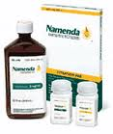
Alzheimer's Disease
Moderate-SEVERE (pick 1) | Drug | Brand | Dosing | Side Effects
ACh Esterase Inhibitor | Donepezil | Aricept | 5 mg HS | Diarrhea
NMDA antagonist (N-Methyl-D-Aspartate) | Memantine | Namenda | IR: 5 mg daily XR: 7 mg daily | Constipation HTN
OR
Any (previous slide) ACh Esterase Inhibitor
+
Memantine (Namenda)

Slide 3
Aphasia: is an impairment of language ability
Apraxia: a person has trouble saying what he or she wants to say correctly and consistently. It is NOT due to weakness or paralysis of the speech muscles
Agnosia: is a loss of ability to recognize objects, persons, sounds, shapes, or smells while the specific sense is not defective nor is there any significant memory loss
LACK of Efficacy: clinical deterioration during the first 6 months of therapy (drug does not work)
LOSS of Efficacy: clinical deterioration after at least 6 months of successful therapy (worked but then does not)

Slide 4
Dementia | Delirium
Chronic Disorder | Acute Disorder
No change in consciousness | Change in consciousness
Progressive | Resolves and Starts Again
Fix AD with ACh
Dementia: Syndrome of abnormal deterioration of memory and cognitive function
Vitamin B3 or B12 deficiency
Alzheimer's Disease
AD
Brain infection
Alcohol
Vascular Disease
Ex: stroke
 | Alzheimer's | Typical Age
S/S | Misplaced and UNABLE to retrace steps | Misplace things but ABLE to retrace back
Cause | Age, Environment
Genes | Chromosome 14 & 1 → Presenilin 1 & 2 →APP → βAP (Plaque) Apolipoprotein E 2 REDUCE risk of AD Apolipoprotein E 4 INCREASE risk of AD
ADL | Activities of Daily Living (ADL): eating, bathing (self care) Instrumental Activities of daily Living (IADL): shopping, cooking
Notes:
DSM-IV-TR

Slide 5
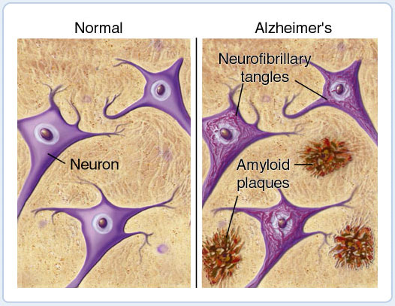
Causes:
1: Chromosome 14 & 1 → Presenilin 1 & 2 → APP (Amyloid precursor protein) → Beta amyloid fragments
APP (string like) binds to the neuron membrane
Beta amyloid cuts the APP
Cut APP becomes Beta Amyloid Fragments and clumps up
2: Apolipoprotein E 2 REDUCE risk of AD
3: Apolipoprotein E 4 INCREASE risk of AD
4: Neurofibrillary Tangles (NFT) → decrease Acetylcholine

Slide 6
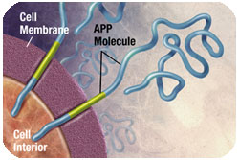
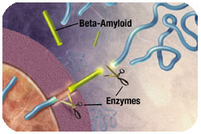
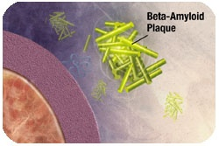
Neuritic (β-amyloid) Plaques
Amyloid precursor protein (APP) is the precursor to amyloid plaque.
1. APP sticks through the neuron membrane.
2. Enzymes cut the APP into fragments of protein, including beta-amyloid.
3. Beta-amyloid fragments come together in clumps to form plaques.
1.
2.
In AD, many of these clumps form disrupting the work of neurons and eventually neuronal cell death.
3.

